Slide 1

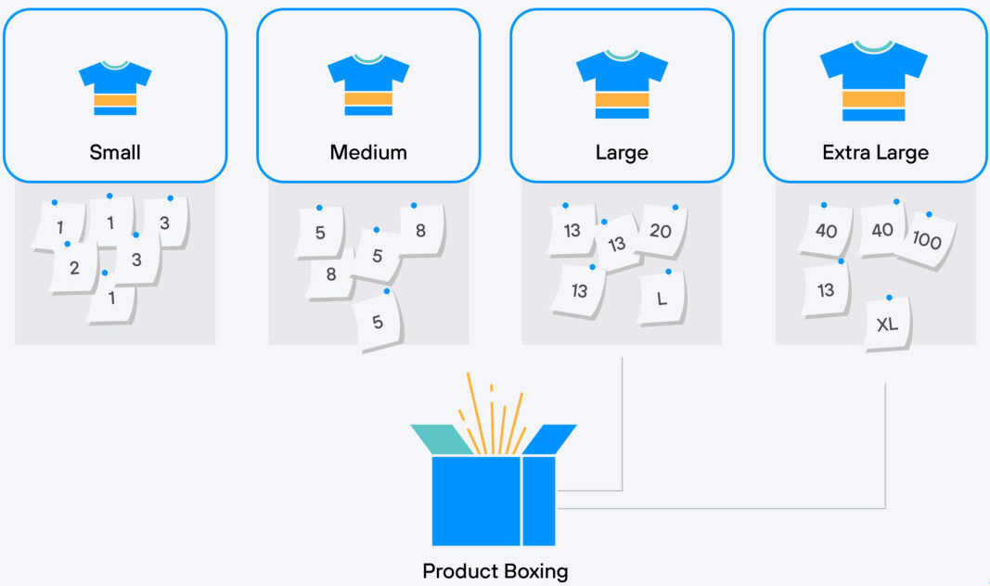
Agile Estimation Quiz
https://bit.ly/3yszu9w

